Slide 1
BLOCK RENOVATION
Quarterly Marketing Source Analysis
Author: Thien Win
Date: 6/15/2022
win.thien@gmail.com

Slide 2
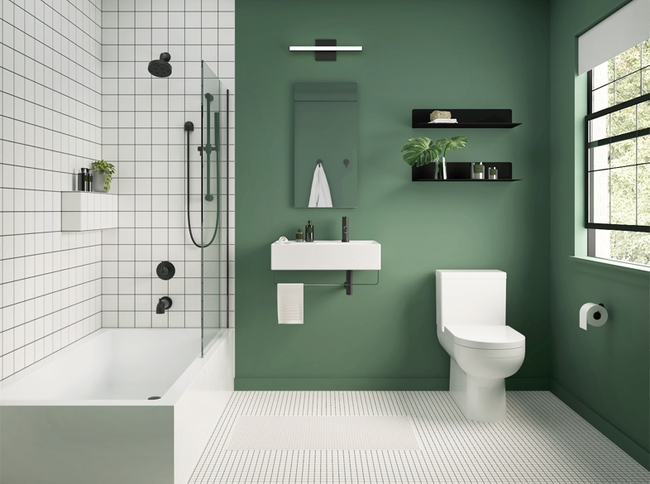
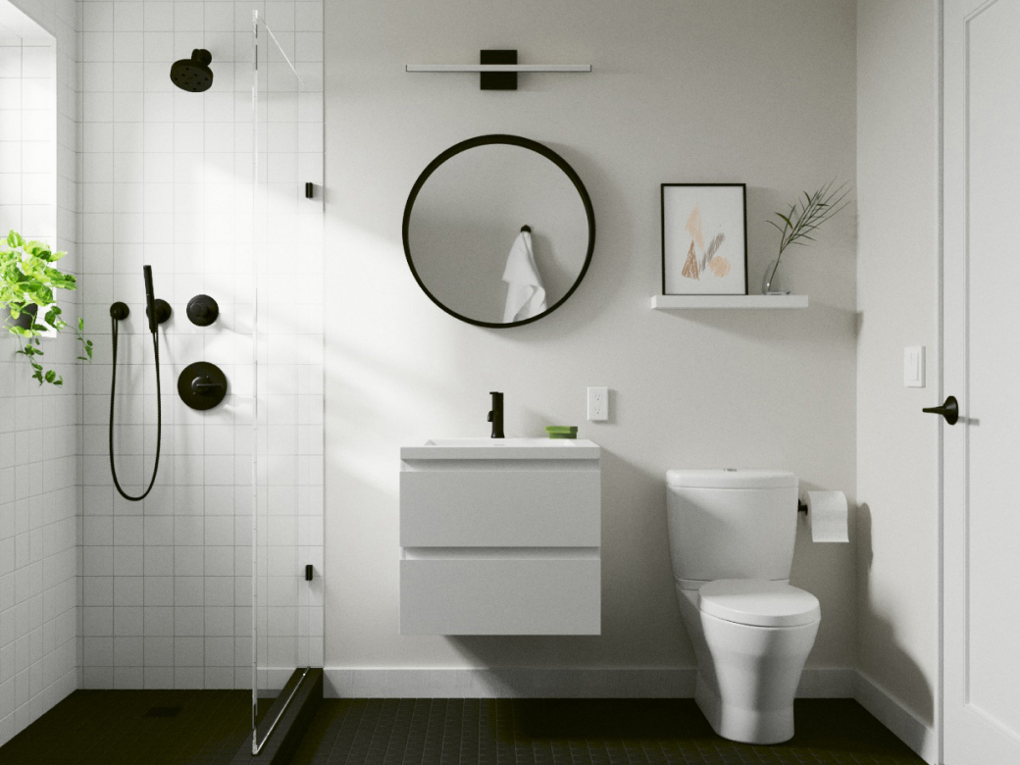
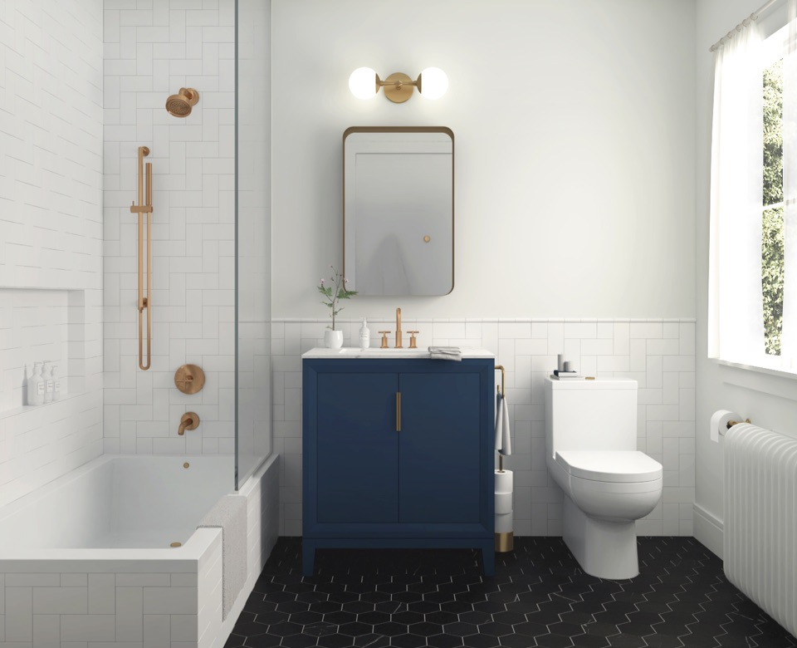
The why…
Utilizing the available data, I look to achieve the following:
Provide insight on marketing source quarterly performance
Institute a pseudo-benchmark for source comparison
Make recommendations to drive marketing efforts and action

Slide 3
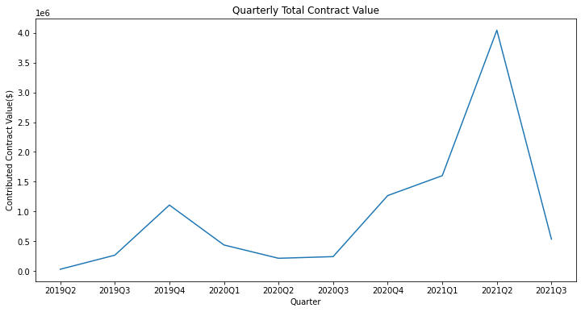
Quarterly Performance:
Four quarters of growth from 2020Q2 to 2021Q2 (+1,583% increase)
+152% increase - 2021Q1 to 2021Q2
-86% decrease - 2021Q2 to 2021Q3

Slide 4
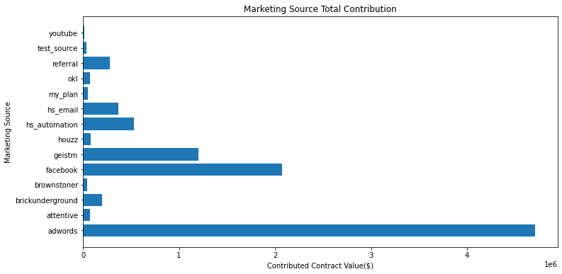
Source Performance:
Adwords has contributed the most to total of won contracts
Facebook and Geist M strong supporters
Youtube has contributed the least

Slide 5
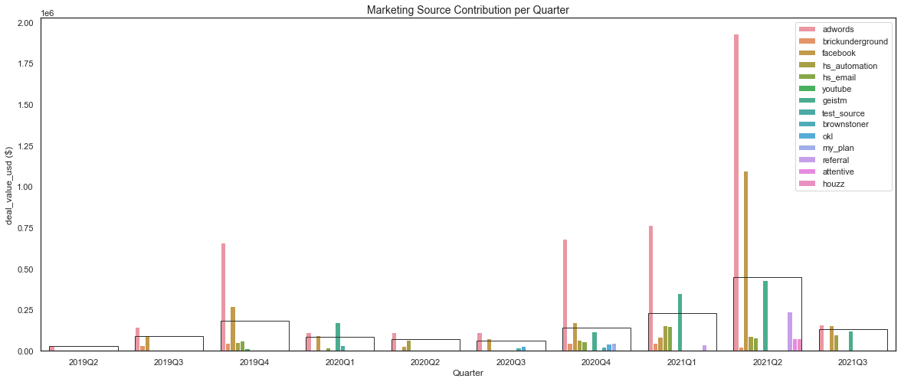
Source Performance per Quarter:
Adwords consistently outperforms the quarterly average
Facebook contribution +1,153% from 2021Q1 to 2021Q2
Geist M has shown increased contribution 2020Q4 to 2021Q2

Slide 6
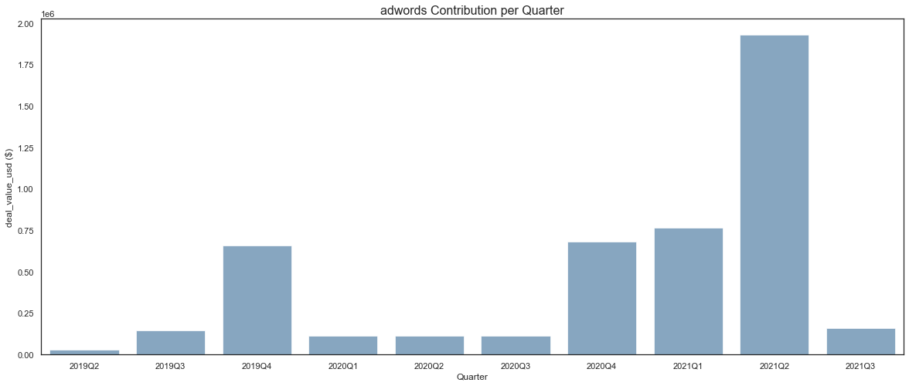
Adwords - consistently above quarterly average, large increase in 2021Q2

Slide 7
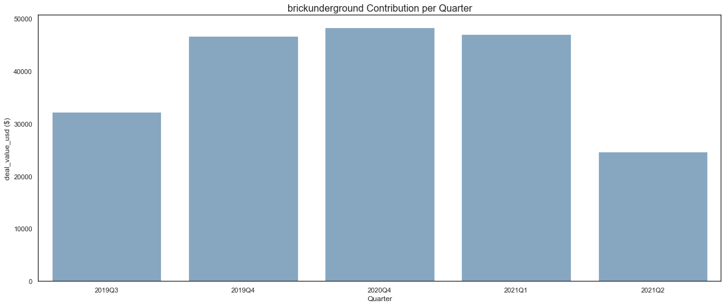
Brick Underground - inconsistent in contribution, below quarterly average

Slide 8
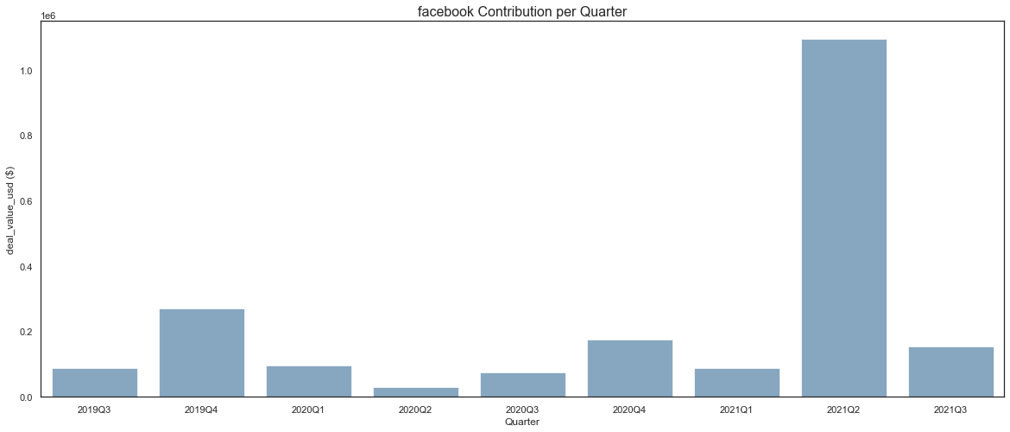
Facebook - consistent contributor, large growth seen in 2019Q5 and 2021Q2

Slide 9
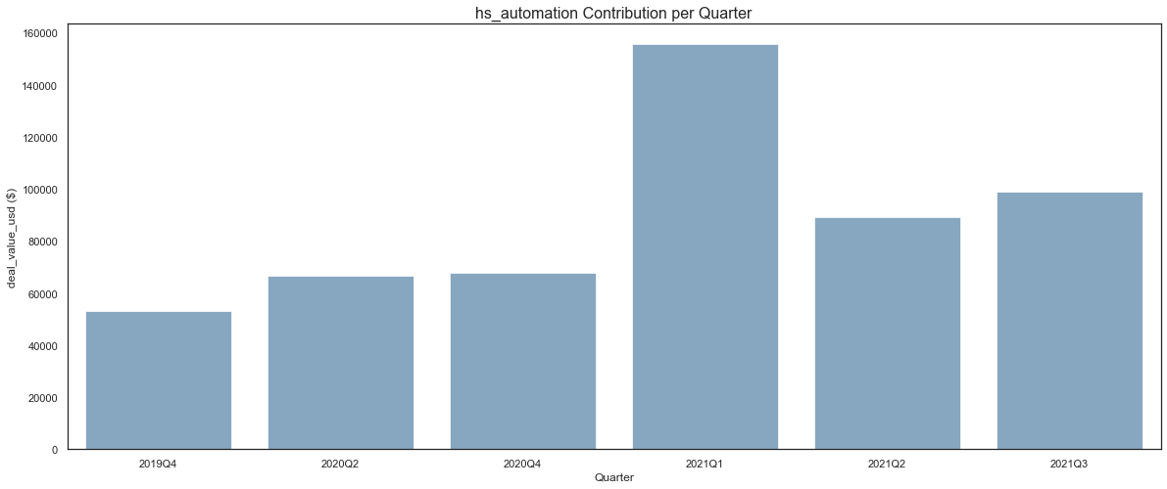
HS Automation - inconsistent, well below average

Slide 10
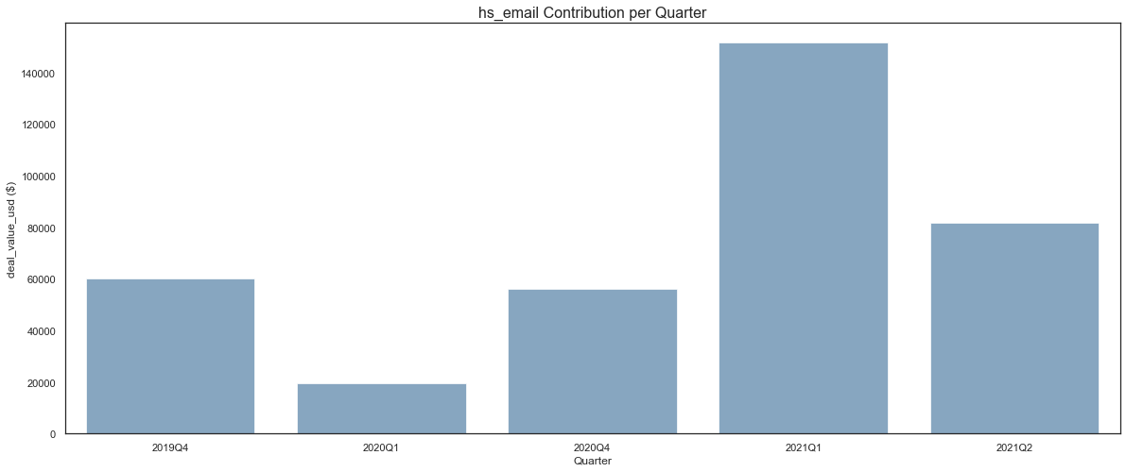
HS Email - inconsistent, well below average

Slide 11
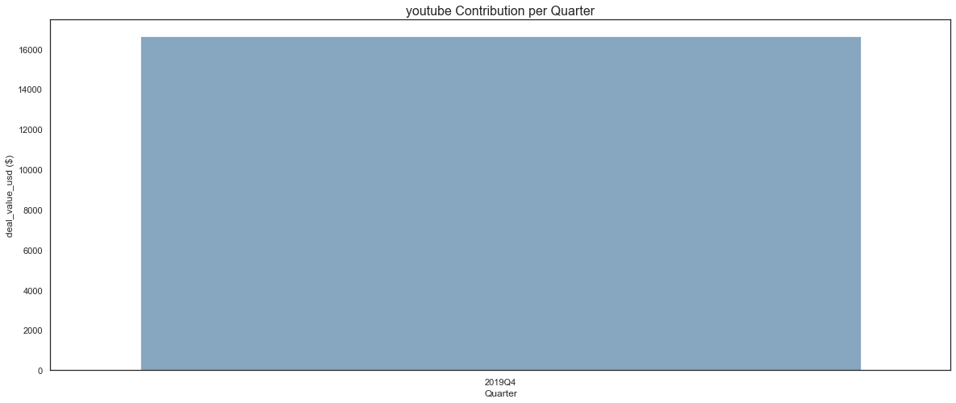
Youtube - one point for comparison, well below average, surprising not more

Slide 12
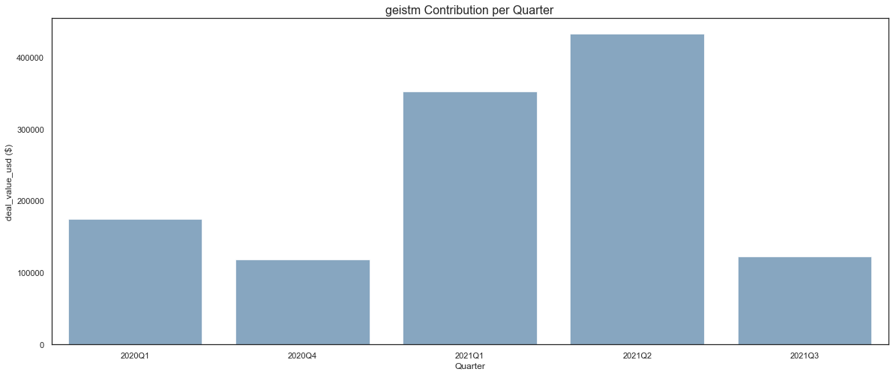
Geist M - inconsistent contributor, impactful when it does contribute

Slide 13
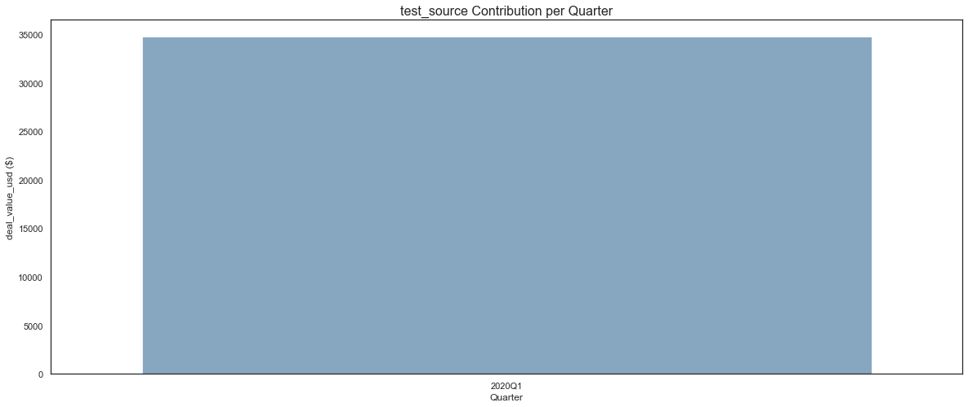
Test Source - one point for comparison, below average

Slide 14
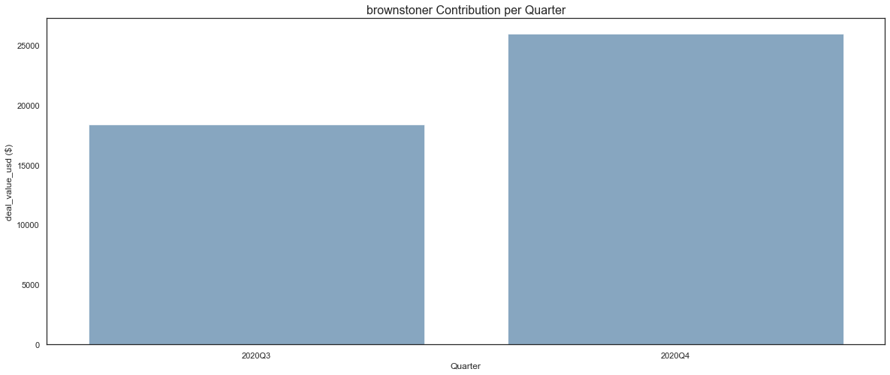
Brownstoner - slight increase from coinciding quarters, below average

Slide 15
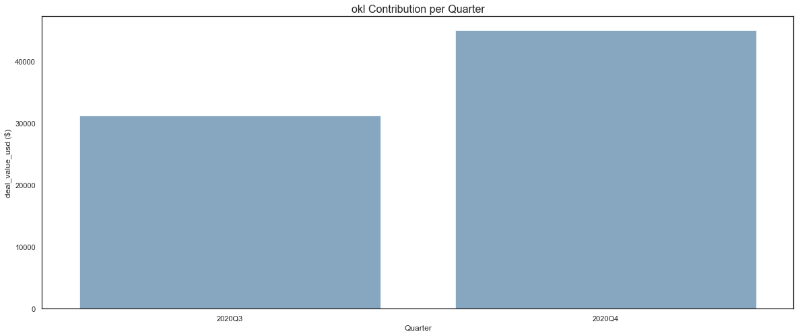
OKL - slight increase from coinciding quarters, below average

Slide 16
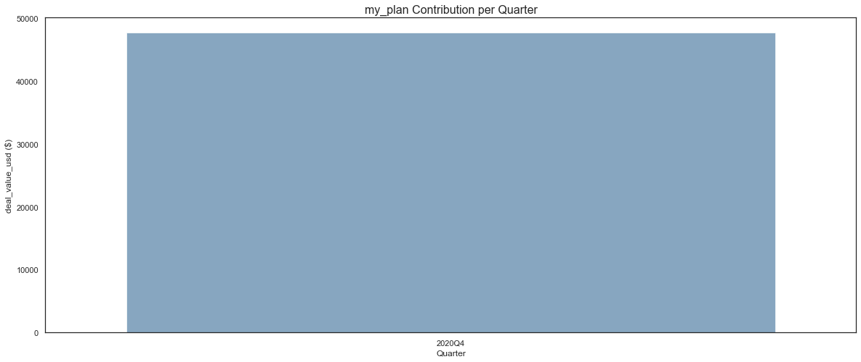
My Plan - one point for comparison, below average

Slide 17
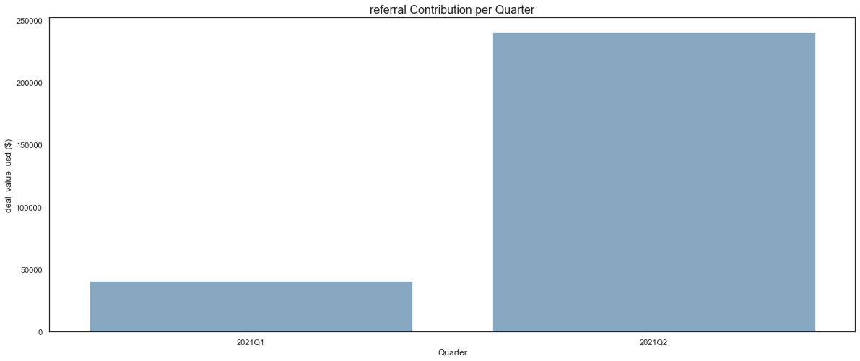
Referral - large increase from coinciding quarters, below average

Slide 18

Attentive - only one point for comparison, well below average

Slide 19

Houzz - only one point for comparison, below average

Slide 20
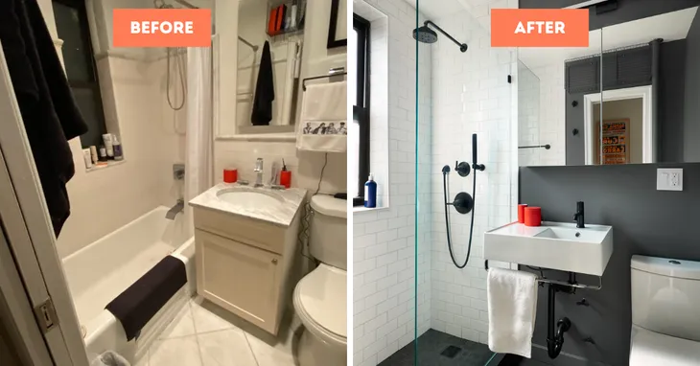
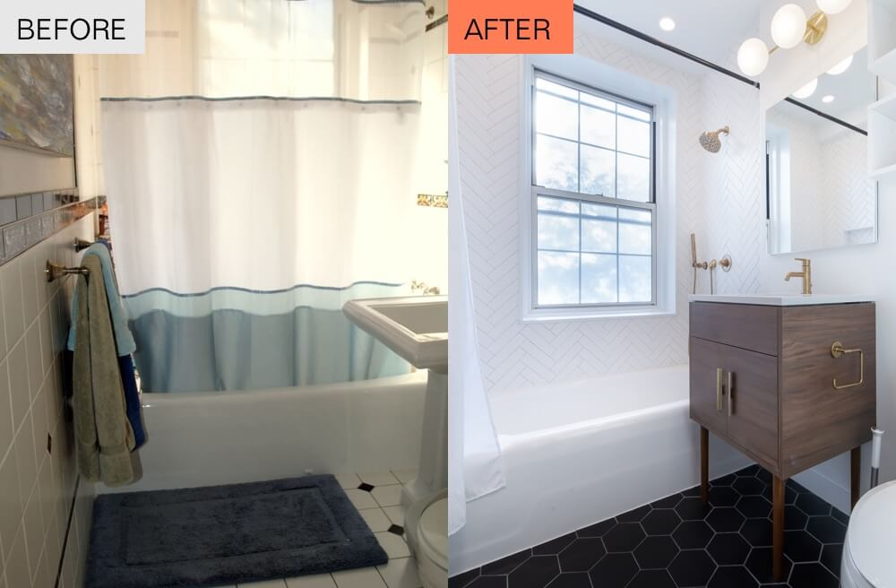
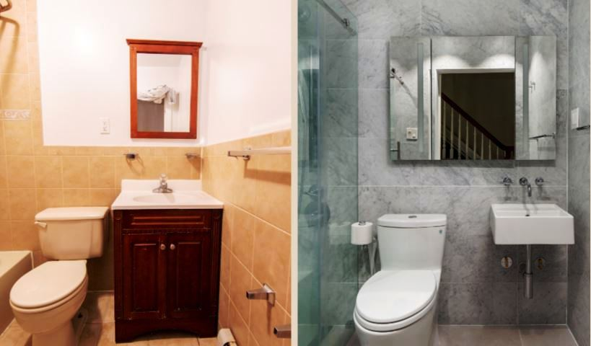
Limitations
Some factors that may skew analysis:
Much, if not all of the data has occurred in a pandemic environment which may have limited the potential effectiveness of these marketing efforts
Additional context for these efforts such as cost, campaign duration etc. could elevate this analysis further
Limited/incomplete data

Slide 21

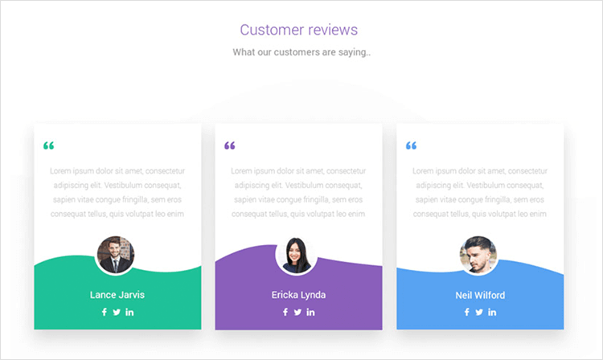

Recommendations:
1. Request that each employee post about Block Renovation on their professional/personal social media page, offering an incentive for referral.
2. Generate more video content for Facebook and Youtube to increase visibility and educate people on the process and benefits. Case Studies and testimonials could be great here.
3. Maintain efforts on Adwords source as that has been proven to contribute the most to quarterly success.
4. Further analysis of unsigned/rejected proposals, ROI on marketing efforts, and average deal amount per source.
5. Increase visibility on Geist M as that has shown potential of exceeding the quarterly average.

Slide 22
Questions?

